Slide 1
How to contact Huawei Digital Power Support - TAC
CEE & Nordic Digital Power
Notes:
非常感谢各位嘉宾莅临此会

Slide 2
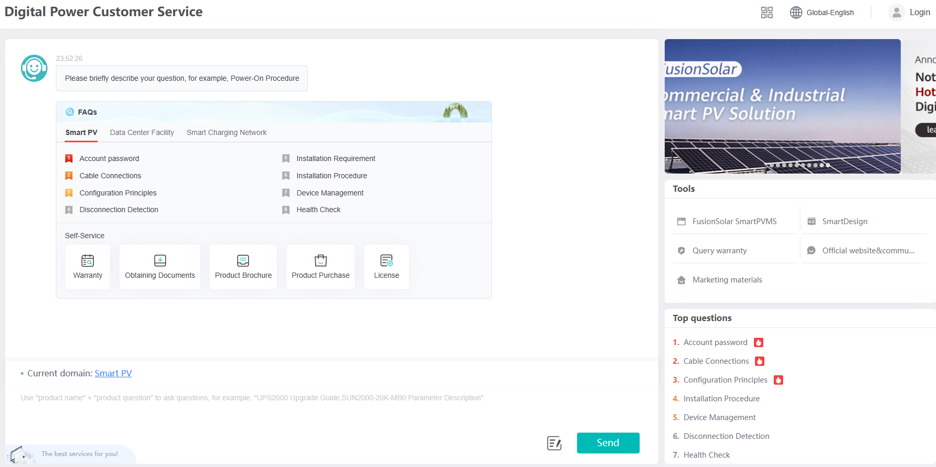
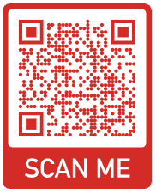
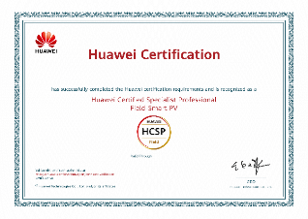
01
Knowledge of technology – The Absolute Basis
Find out all available information about the equipment to be serviced, including its specifications and technical documentation. You can do this in our unprecedented tool on the link below, where you can learn as much information about the issue, including datasheets and video tutorials. Don't be afraid to use the chatbot. It works great.
https://digitalpower.huawei.com/robotchat/#/home/index/home-page?lang=en_US

Slide 3
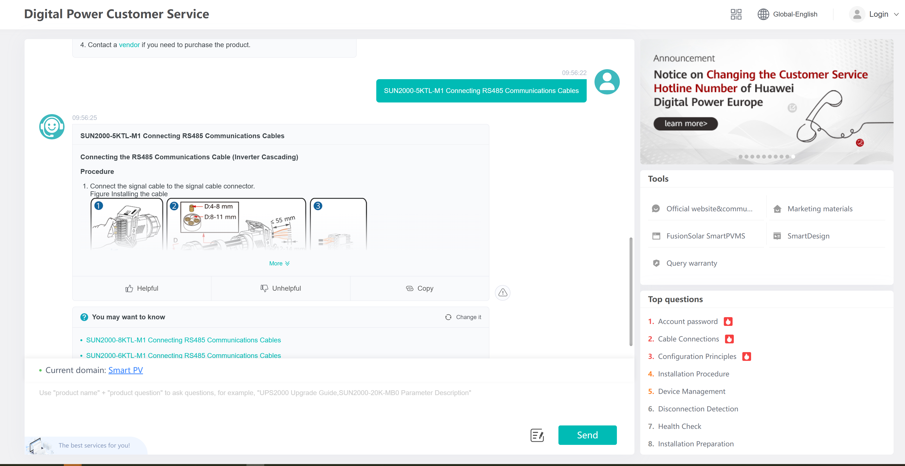
02
Web page - Huawei Digital Power Support
https://digitalpower.huawei.com/robotchat/#/home/index/home-page?lang=en_US
Select Language
Insert your text question and press Send button

Slide 4
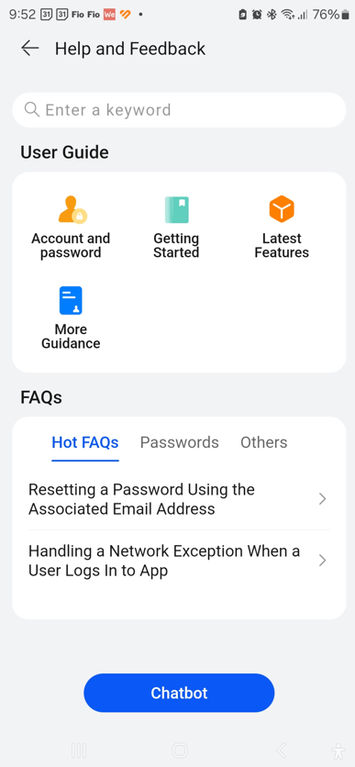
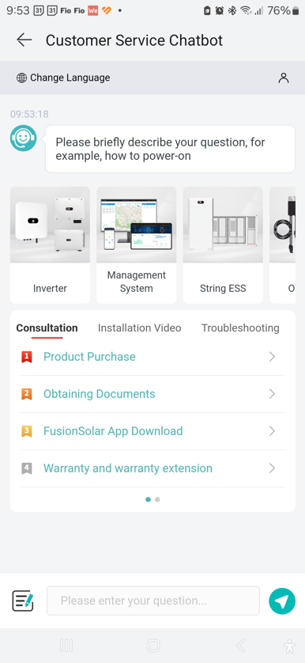
03
Fusion Solar APP - Huawei Digital Power Support
Seach need informations
Insert your question and press Send botton
Start Chatbot communication

Slide 5
04
How to contact us – Huawei Digital Power Support
You can create a service request as follows :
Phone: 00800 33 666 666 – hotline
email: eu_inverter_support@huawei.com
https://digitalpower.huawei.com/robotchat/#/home/index/home-page?lang=en_US

Slide 6
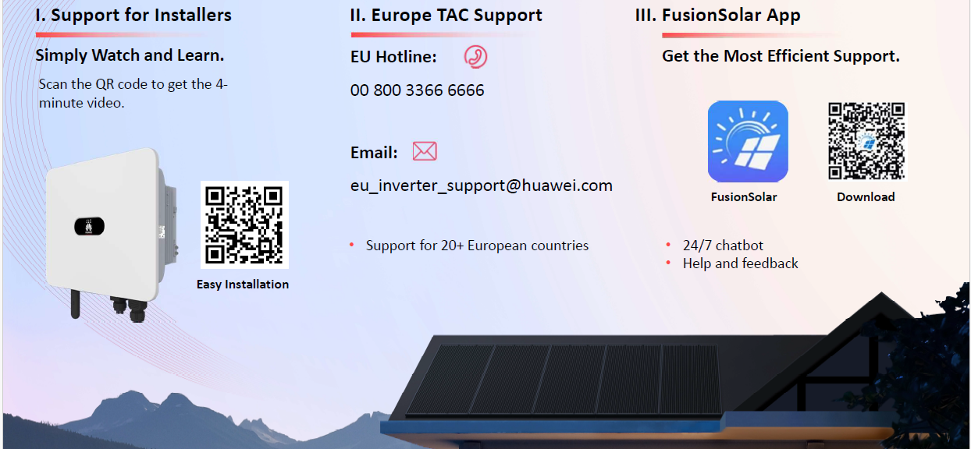
05
How to contact us – Huawei Digital Power Support

Slide 7
06
Necessary information to report a service request.
Logs from the device – download logs from the device. This step is absolutely necessary for the operator to perform a detailed analysis of the problem equipment.
Description of the problem – describe the technical problem in the maximum possible detail. The more information the operator receives from you, the faster it will be able to find an answer to your request. Don't forget the serial numbers and alarm ID!
Photos, video – if possible, provide operators with photo wiring, prinstsreeny screens with alarms, photos of measured values from devices, connection of connectors (e.g. a pin for RS485 etc.)
Sending service request to email: eu_inverter_support@huawei.com
VŠECHNY TYTO INFORMACE USNADNÍ OPERÁTORŮM PRÁCI, VÁM ČAS I PENÍZE Z DŮVODU OPAKOVANÝCH NÁVŠTĚV MÍSTA INSTALACE!

Slide 8
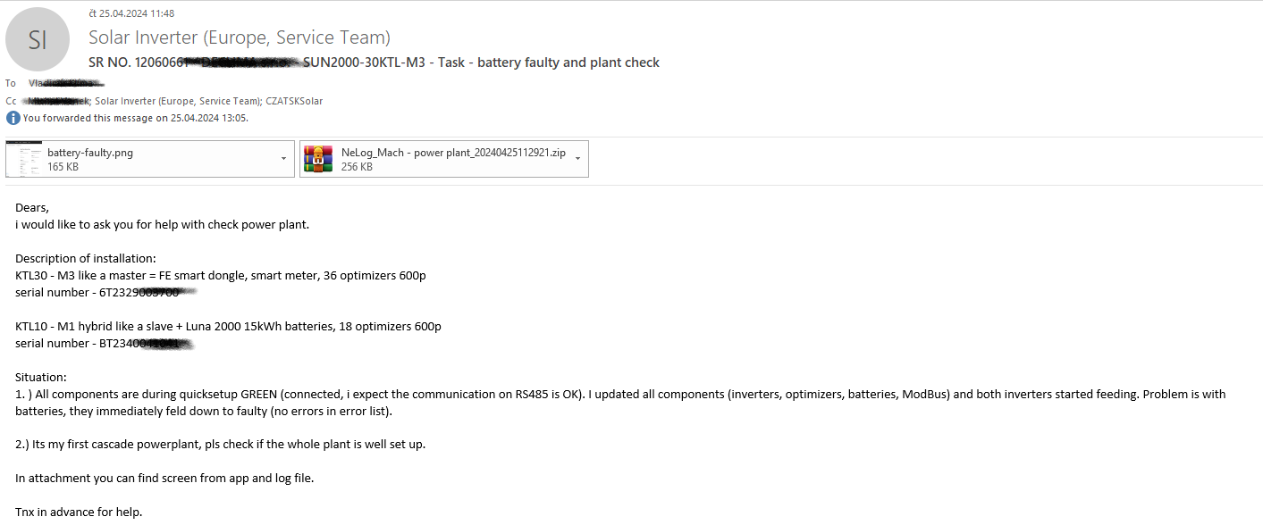
Example of issued service requirement
07
Send to this email
Do not forget attachments
Describe the defect in detail

Slide 9
Active communication with Huawei support operators
08
If possible, keep the technology online, i.e. connected to the Solar Cloud Fusion. This step will allow operators to possibly remotely invest the fault.
TAC (Huawei Support) operators may have additional requirements to address the technology problem. Respond to their calls within a maximum of two working days, unless otherwise agreed. Requirements without response will be automatically closed and you will need to re-create the request. This is not suitable for either side.
Every defective part you require to create a service request must be dealt with individually. It is not possible to solve multiple pieces of technology in one request. This has an impact on the handling of any complaint.

